Slide 1
4. TCP/IP & Software Tools
Intrusion Detection Module
Stephen Huang
Department of Computer Science
University of Houston
Notes:
Proceedings of IEEE Symposium on Security and Privacy, 1996

Slide 2
Overview
TCP State Machine
Three Ways Handshake
TCPDump
Wireshark

Slide 3
TCP State Machine
closed
listen
SYN Rec’d
SYN sent
established
Close wait
FIN wait 1
Last ACK
Fin wait 2
Time wait

Slide 4
Server Side Passive Open
closed
Passive open
SYN
listen
SYN / SYN+ACK
SYN+ACK
SYN Rec’d
SYN sent
ACK
established
Close wait
ACK
FIN wait 1
Last ACK
Fin wait 2
client
server
Time wait

Slide 5
Client Side Active Open
closed
SYN
listen
Active open/ SYN
SYN+ACK
SYN Rec’d
SYN sent
SYN+ACK / ACK
established
Close wait
ACK
FIN wait 1
Last ACK
Fin wait 2
client
server
Time wait

Slide 6
Server Side Passive Close
closed
FIN+ACK
listen
SYN Rec’d
SYN sent
ACK
FIN / ACK
established
Close wait
FIN
Close / FIN
ACK
FIN wait 1
Last ACK
ACK
Fin wait 2
client
server
Time wait

Slide 7
Client Side Active Close
closed
FIN+ACK
listen
SYN Rec’d
SYN sent
ACK
established
Close wait
FIN
Timeout
Close / FIN
ACK
FIN wait 1
Last ACK
ACK
FIN wait 2
FIN / ACK
client
server
Time wait

Slide 8
SYN Open
SYN
SRC: 1234 DST: 80
Seq: 100 Ack: 0
SYN
SYN, ACK
SRC: 80 DST: 1234
Seq: 300 Ack: 101
SYN+ACK
ACK
SRC: 1234 DST: 80
Seq: 101 Ack: 301
ACK
client
server

Slide 9
SYN Close
FIN+ACK
ACK
SRC: 80 DST: 1234
Seq: 301 Ack: 102
FIN, ACK
SRC: 1234 DST: 80
Seq: 101 Ack: 301
ACK
FIN, ACK
SRC: 80 DST: 1234
Seq: 301 Ack: 102
FIN
ACK
SRC: 1234 DST: 80
Seq: 102 Ack: 302
ACK
client
server

Slide 10
Reliability through acknowledgement
If sent data is not ack’ed, it is retransmitted
Ack’s are piggy-backed on outgoing traffic
Delayed Ack, wait ~200 ms for outgoing traffic

Slide 11
Data Flow
ACK, PSH
SRC: 1234 DST: 80
Seq: 101 Ack: 301
‘a’
ACK
SRC: 80 DST: 1234
Seq: 301 Ack: 102
ACK
ACK, PSH
SRC: 1234 DST: 80
Seq: 102 Ack: 301
‘b’
ACK
SRC: 1234 DST: 80
Seq: 103 Ack: 302
‘c’
FIN, ACK
SRC: 80 DST: 1234
Seq: 301 Ack: 104
ACK
client
server

Slide 12
Bulk Data Flow
Ack: 7
Win: 12
01 02 03 04 05 06 07 08 09 10 11 12 13 14 15 16 17 18 19 20 21 22 23
Sent &
Ack’ed
Cannot Send
Sent,
not Ack’ed
Can Send ASAP

Slide 13
TCPDump
A Unix tool used to
gather data from the network,
decipher the bits, and
display the output in a semi coherent way.

Slide 14
Software
TCPDump: ftp://ftp.ee.lbl.gov/tcpdump.tar.z
Libpcap: ftp://ftp.ee.lbl.gov/libpcap.tar.z, a portable framework for capturing low-level network traffic
An improved version: www.tcpdump.org
A Windows version: http://netgroup.serv.polite.it/windump
Wireshark: http://www.wireshark.org/

Slide 15
TCPDump Behavior
Most OS requires root access to run the program.
By default, it reads all network traffic from the interface.
It writes the output to the console.
Command line options are available to alter the default behavior.

Slide 16
Filters
Filter: can specify the records that you are interested in collecting.
Filter Language: to denote the field(s) that should be examined if certain conditions are met.
“tcpdump tcp”

Slide 17
Options
Filter can be stored in a file: -F filename
Output Formats:
Readable (default format for console display)
Binary (default format for file storage, less space, faster)
To write to a file: -w filename
To read from a saved file: -r filename

Slide 18
Sample Output
23:29:04.050167 spider.3224 > 66-28-147-032.servercentral.net.6020: . ack 36517 win 16044
23:29:04.059645 66-28-147-032.servercentral.net.6020 > spider.3224: P 36517:37969(1452) ack 1 win 5840 (DF)
23:29:04.092955 daffy.pmatulis.homeunix.net.netbios-ns > 192.168.1.255.netbios-ns: nbt-query-req-bcast
23:29:04.093587 daffy.pmatulis.homeunix.net.netbios-ns > 192.168.1.255.netbios-ns: nbt-query-req-bcast
23:29:04.093836 mudra.pmatulis.homeunix.net.netbios-ns > daffy.pmatulis.homeunix.net.netbios-ns: nbt-query-positive-resp (DF)

Slide 19
Binary Format (Hex)
4510 0068 7e87 4000 4006 3862 c0a8 011e
c0a8 0128 0016 0479 b6c8 a8de 621e 87db
5018 4470 1813 0000 e492 152f 23c3 8a2b
4ee7 dbf8 0d48 88e8 0110 2b01 4295 39f4
52c9 a05b 31d7 e3ae 1c62 2dbd d955 d604
b5d2 63d1 8fbc 4ab7 1615 b382 571c 70e0
a368 a03f 425b 6211

Slide 20
Data Selection
To select the first “snaplen” bytes of the packet, use –s snaplen.
> tcpdump –s 1514 (max. Ethernet length + link layer header)
> tcpdump –s 68 (Just the headers)

Slide 21
Sample Ethernet Packet
14 bytes 20 bytes 20 bytes 14 bytes
Frame Header
IP Header
TCP Header
TCP Data
Embedded protocol (TCP, UDP, ICMP)
IP Datagram
Ethernet Frame

Slide 22
Understanding the Output
09:32:43:910000 nmap.edu.1173 > dns.net.21 S 62697789:62697789(0) win 512

Slide 23
Understanding the Output
09:32:43:910000 nmap.edu.1173 > dns.net.21 S 62697789:62697789(0) win 512
Time Stamp hh:mm:ss followed by fraction of a second

Slide 24
Understanding the Output
09:32:43:910000 nmap.edu.1173 > dns.net.21 S 62697789:62697789(0) win 512
Source host name, or the IP number

Slide 25
Understanding the Output
09:32:43:910000 nmap.edu.1173 > dns.net.21 S 62697789:62697789(0) win 512
Source port number, or service

Slide 26
Understanding the Output
09:32:43:910000 nmap.edu.1173 > dns.net.21 S 62697789:62697789(0) win 512
Directional flow

Slide 27
Understanding the Output
09:32:43:910000 nmap.edu.1173 > dns.net.21 S 62697789:62697789(0) win 512
Destination host name

Slide 28
Understanding the Output
09:32:43:910000 nmap.edu.1173 > dns.net.21 S 62697789:62697789(0) win 512
Destination port number (21 for FTP)

Slide 29
Understanding the Output
09:32:43:910000 nmap.edu.1173 > dns.net.21 S 62697789:62697789(0) win 512
TCP flag (S, Ack, F, R, P, urg, .)

Slide 30
Understanding the Output
09:32:43:910000 nmap.edu.1173 > dns.net.21 S 62697789:62697789(0) win 512
Beginning TCP sequence number.
Ending TCP sequence number
(data bytes)

Slide 31
Understanding the Output
09:32:43:910000 nmap.edu.1173 > dns.net.21 S 62697789:62697789(0) win 512
Receiving buffer (window) size in bytes for this connection.

Slide 32
UDP datagram
15:22:41.400299 orac.erg.abdn.ac.uk.1052 > 224.2.156.220.57392: udp 110
Timestamp 15:22:41.400299

Slide 33
UDP datagram
15:22:41.400299 orac.erg.abdn.ac.uk.1052 > 224.2.156.220.57392: udp 110
Source address orac.erg.abdn.ac.uk

Slide 34
UDP datagram
15:22:41.400299 orac.erg.abdn.ac.uk.1052 > 224.2.156.220.57392: udp 110
Source port 1052

Slide 35
UDP datagram
15:22:41.400299 orac.erg.abdn.ac.uk.1052 > 224.2.156.220.57392: udp 110
Destination address 224.2.156.220

Slide 36
UDP datagram
15:22:41.400299 orac.erg.abdn.ac.uk.1052 > 224.2.156.220.57392: udp 110
Destination port 57392

Slide 37
UDP datagram
15:22:41.400299 orac.erg.abdn.ac.uk.1052 > 224.2.156.220.57392: udp 110
Protocol udp

Slide 38
UDP datagram
15:22:41.400299 orac.erg.abdn.ac.uk.1052 > 224.2.156.220.57392: udp 110
Size 110

Slide 39
TCP datagram
16:23:01.079553 churchward.erg.abdn.ac.uk.33635 > gordon.erg.abdn.ac.uk.32772: P 12765:12925(160) ack 19829 win 24820 (DF)
Timestamp 16:23:01.079553

Slide 40
TCP datagram
16:23:01.079553 churchward.erg.abdn.ac.uk.33635 > gordon.erg.abdn.ac.uk.32772: P 12765:12925(160) ack 19829 win 24820 (DF)
Source address churchward.erg.abdn.ac.uk

Slide 41
TCP datagram
16:23:01.079553 churchward.erg.abdn.ac.uk.33635 > gordon.erg.abdn.ac.uk.32772: P 12765:12925(160) ack 19829 win 24820 (DF)
Source port 33635

Slide 42
TCP datagram
16:23:01.079553 churchward.erg.abdn.ac.uk.33635 > gordon.erg.abdn.ac.uk.32772: P 12765:12925(160) ack 19829 win 24820 (DF)
Destination address gordon.erg.abdn.ac.uk

Slide 43
TCP datagram
16:23:01.079553 churchward.erg.abdn.ac.uk.33635 > gordon.erg.abdn.ac.uk.32772: P 12765:12925(160) ack 19829 win 24820 (DF)
Destination port 32772

Slide 44
TCP datagram
16:23:01.079553 churchward.erg.abdn.ac.uk.33635 > gordon.erg.abdn.ac.uk.32772: P 12765:12925(160) ack 19829 win 24820 (DF)
PUSH flag is set P

Slide 45
TCP datagram
16:23:01.079553 churchward.erg.abdn.ac.uk.33635 > gordon.erg.abdn.ac.uk.32772: P 12765:12925(160) ack 19829 win 24820 (DF)
Sequence number 12765: Contained data upto but not including 12925 Number of user data bytes (160)

Slide 46
TCP datagram
16:23:01.079553 churchward.erg.abdn.ac.uk.33635 > gordon.erg.abdn.ac.uk.32772: P 12765:12925(160) ack 19829 win 24820 (DF)
Details of acknowledgements

Slide 47
TCP datagram
16:23:01.079553 churchward.erg.abdn.ac.uk.33635 > gordon.erg.abdn.ac.uk.32772: P 12765:12925(160) ack 19829 win 24820 (DF)
Window size

Slide 48
TCP datagram
16:23:01.079553 churchward.erg.abdn.ac.uk.33635 > gordon.erg.abdn.ac.uk.32772: P 12765:12925(160) ack 19829 win 24820 (DF)
Do not fragment

Slide 49
Time Stamps
-t suppresses the timestamp output
orac.erg.abdn.ac.uk.1052 > 224.2.156.220.57392: udp 597
-tt gives an unfomatted time stamp, this value is a count in seconds from the OS clock initial value
1029507868.335134 orac.erg.abdn.ac.uk.1052 > 224.2.156.220.57392: udp 520
-tttt gives the interval between the packet recieved and the previous packet
358020 orac.erg.abdn.ac.uk.1052 > 224.2.156.220.57392: udp 586 328704 orac.erg.abdn.ac.uk.1052 > 224.2.156.220.57392: udp 893

Slide 50
Addresses and Ports
To capture all traffic with host churchward as source or destination address
tcpdump host churchward
To capture all traffic with the tcp or udp, source or destination port number 53
tcpdump port 53
To capture all traffic with the source address churchward
tcpdump src host churchward

Slide 51
Addresses and Ports
To capture all trafffic with the destination tcp or udp port 53
tcpdump dst port 53
To capture all TCP traffic with the source address churchward
tcpdump tcp src host churchward
To capture all trafffic with the destination udp port 53
tcpdump udp dst port 53

Slide 52
Logical Operators
Expressions can be combined using AND and OR with the additional use of NOT.
tcpdump src host churchward and udp dst port 53
tcpdump dst 224.2.127.254 or dst 239.255.255.255
tcpdump dst 224.2.127.254 and not src 139.133.204.110

Slide 53
TCPDump Flags
SYN (S): session establishment request
ACK (ack): acknowledge the receipt of data. May piggyback with other flags.
FIN (F): session termination request.
RESET (R): immediately abort the session.
PUSH (P): Send the data out immediately. Responsiveness over efficiency.

Slide 54
TCPDump Flags
URGENT (urg): An urgent data that should take precedence over other data. (For example, a Control-C to abort an FTP download.)
Placeholder (.) : No flag is set.
Note: The six flags are not necessarily exclusive. It is very common to see P and A together.

Slide 55

Wireshark
Wireshark is very similar to tcpdump, but has a graphical front-end, plus some integrated sorting and filtering options.

Slide 56
Basic WIRESHARK features
WIRESHARK supports hundreds of protocols http://www.wireshark.org/docs/dfref/
Live capture and offline analysis
Multiplatform support: Windows, Linux, Solaris, MAC
Multi-media support: Ethernet, ATM etc.
Rich VOIP analysis
Captured data browsing in GUI or in TTY mode (TSHARK)
R/W many different capture file formats:
tcpdump (libpcap), MS Network Monitor, Network General Sniffer®,
RADCOM WAN/LAN Analyzer and many others.
Output can be exported to XML, PostScript® or simple text
Notes:
The full list of protocols can be found

Slide 57
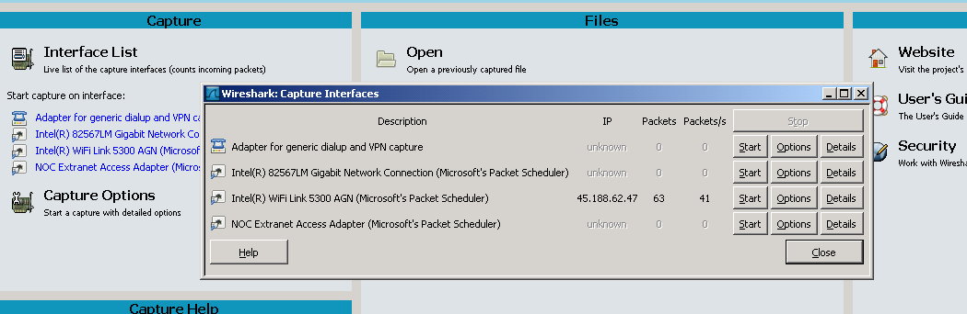
Basic Network packet capturing-1 When you activate the WIRESHARK you get the following view
Notes:
As a matter of fact after choosing an interface from the background of the picture above and then stopping the capture you can get the small window for choosing the same or another interface.

Slide 58
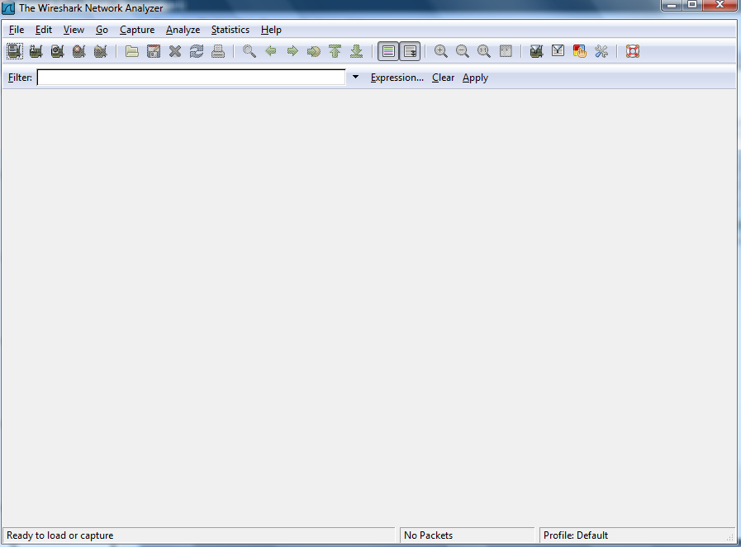
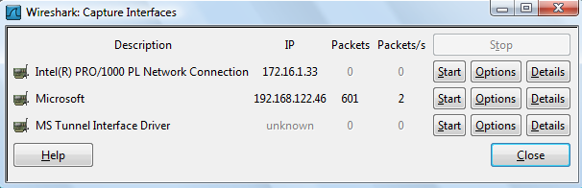
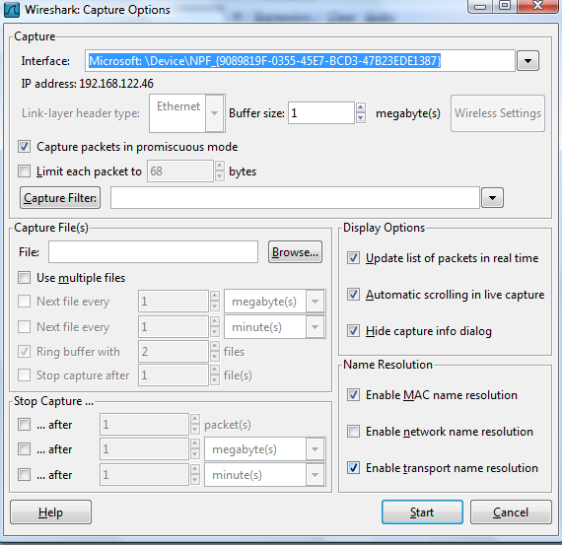
Basic Network packet capturing -2
Notes:
By clicking Capture→ Interfaces→ Options on the Interface menu you choose the interface you want to collect packets from. There are some important fields here.

Slide 59
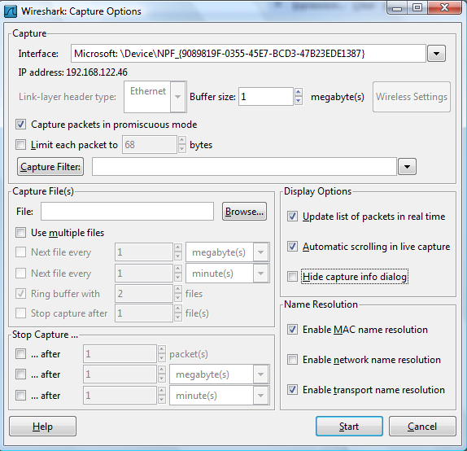
Basic Network packet capturing -3
Notes:
“Capture Packets in promiscuous mode” If you do not click you will only be able to see packets specifically addressed to your computer, unless another process in your computer put the mode to promiscuous mode.
Display Options:
Update list of packets in real time
The packets will be displayed while in capture. If not ticked then all packets will be visible only after the capturing is stopped in WIRESHARK.
Automatic scrolling in live capture
When ticked the scrolling to the last captured packet is done automatically.
Hide capture info dialog
By not ticking that option you will already see some statistics when capturing. Percentage of specific protocols in capture, total captured packets etc.
While capturing the packets are stored in a small buffer. It is possible to save packets while capturing, in a single file or multiple files by limiting the size of each file.
When you press start capturing starts.

Slide 60
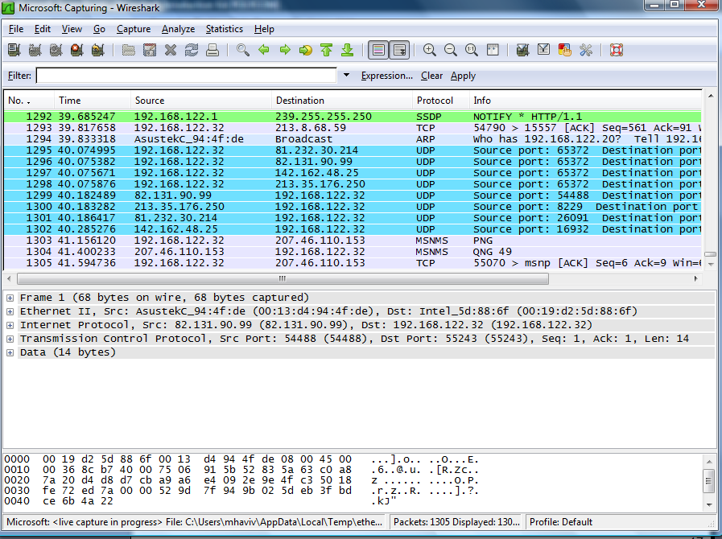
Basic Network packet capturing -4

Slide 61
WIRESHARK preferences
The GUI can be changed for
GUI layout
Columns
Time format
Coloring preferences
Field values for specific protocols
…….
Different profiles can be defined and saved
Notes:
From the main WIRESHARK window choose Edit→Preferences.
Some useful fields:
Time format- Normally it is relative. The first packet arriving at 0.000 seconds.
You can choose absolute time or one packet’s arrival can serve as a REFERENCE from which all the other packets’ arrival times are recomputed.

Slide 62
Basic displayed/captured packet manipulations
Forcing a protocol to an unknown protocol packet
Marking a packet or a group of packets
Saving all or part of the captured packets
Exporting a trace
Printing all or part of the captured packets
Notes:
Some protocols do not have default port numbers and/or unrecognized and as such we need to tell WIRESHARK how to parse them.

Slide 63
Display filtering
By arranging the display sort field/order changed
Sort order of time/packet number
Sort order per IP/MAC address of source/destination
Sort order per protocol
By marking specific packets manually
By configuring filters for
Address
Protocol
Protocol field value
Frame length
String

Slide 64
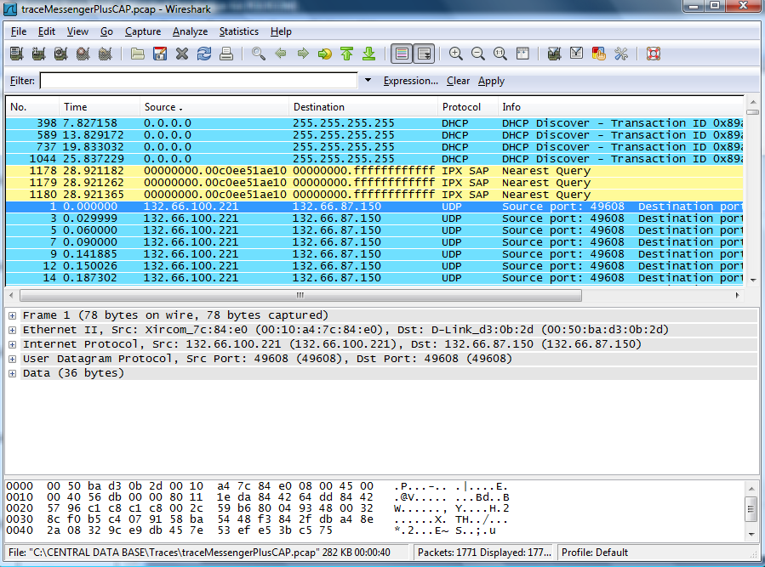
Display filtering- by changing display sort order
Notes:
The display above has been obtained on a previously captured file. It is ordered by source address. It is achieved by clicking on the “Source” column. Other types of ordering can also be used. I advise to play with that.

Slide 65
Some simple filter examples
ip.addr == 234.78.12.78
ip.src != 10.0.0.2
sip.Method==REGISTER
h263.unrestricted_motion_vector == 0
sip.from.addr == "sip:39260722@10.7.0.4“
h245.masterSlaveDetermination

Slide 66
Capture filtering
When capturing packets they are stored in temporary files on the computer
We can configure WIRESHARK to capture packets directly to a single or multiple files
For heavy traffic network capturing or long time capturing the file/buffer sizes might overwhelm the computer or might even crash it.
To prevent accumulating huge file/files if we know what we are looking for we should apply capture filtering

Slide 67
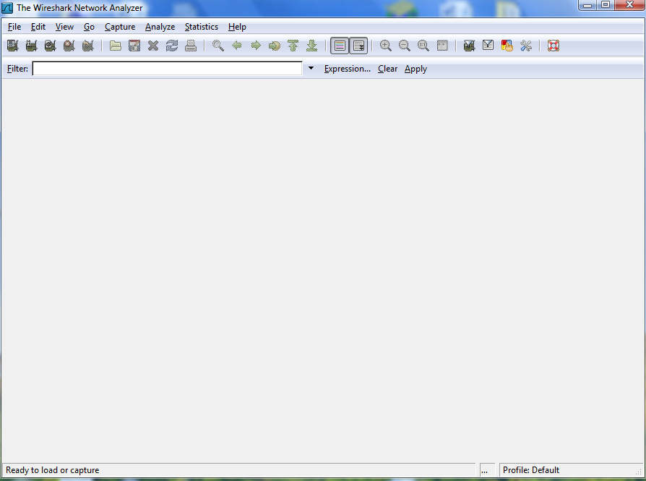
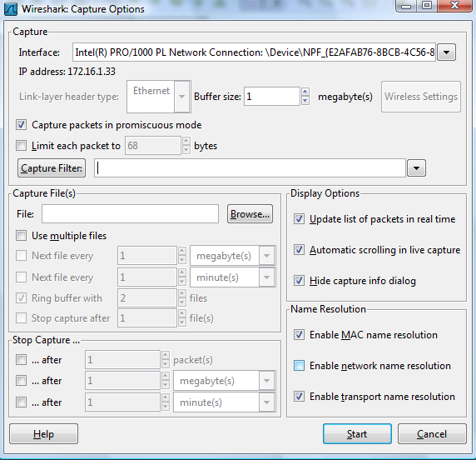
Capture filtering

Slide 68
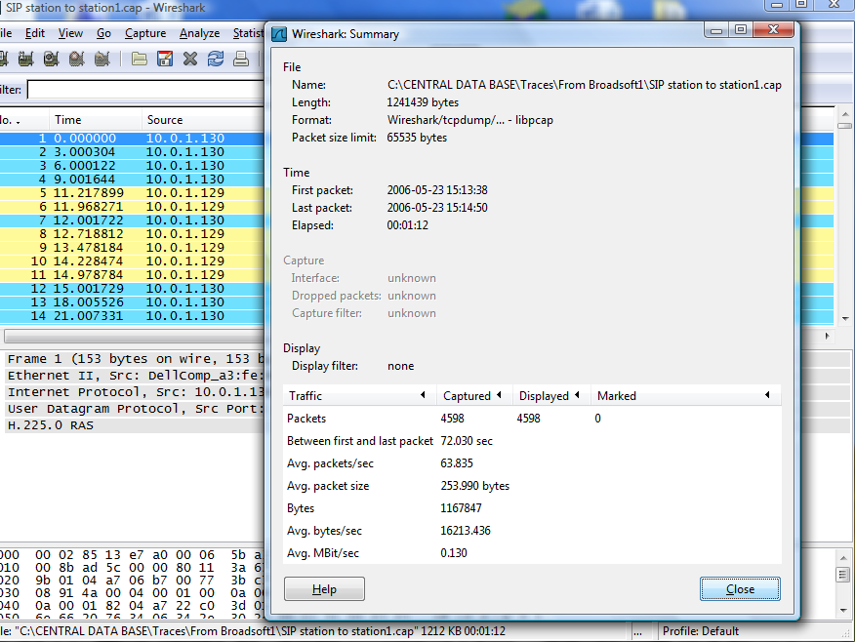
Statistics menu – Statistics→Summary

Slide 69
Other Tools
Ethereal
Free
Can be used for Windows or Unix
Etherape
Like Ethereal, GUI
Snort
Open source
Capable of real-time traffic analysis and logging

Slide 70
Snort
A straight packet sniffer like tcpdump
A packet logger
A full blown network intrusion detection system
http://www.snort.org

